Slide 1


Capstone Project Design and development of a CPU scheduling using operation system simulator
PRESENTED BY:
M.NAGA SHALINI(192524183)
G.BHARGAVI(192525126)
S.CHAITANYAPRIYA(192525372)
V.SAI ANUGNA(192511229)
GUIDED BY:
PROF. DR.SUNDAR RAJAN

Slide 2
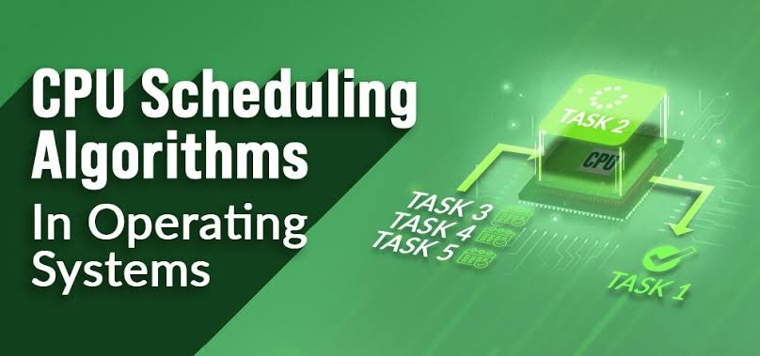
Introduction
CPU scheduling is an important function of an operating system.
It decides which process gets the CPU first.
CPU scheduling helps the system run efficiently.
It improves CPU utilization and system performance.
It reduces waiting time and turnaround time.
Different scheduling algorithms are used for different situations.
A CPU Scheduling Simulator shows how these algorithms work.
It calculates waiting time, turnaround time, and completion time.

Slide 3
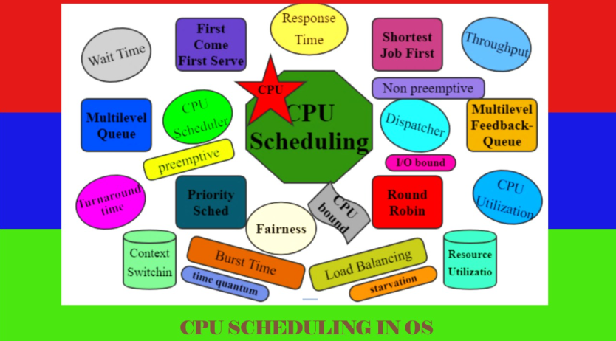
Objectives
To design and develop a CPU Scheduling Simulator.
To simulate different CPU scheduling algorithms.
To calculate waiting time, turnaround time, and completion time.
To display the execution order using a Gantt Chart.
To compare the performance of different scheduling algorithms.
To improve CPU scheduling understanding through simulation.
To provide a simple and user-friendly interface.

Slide 4
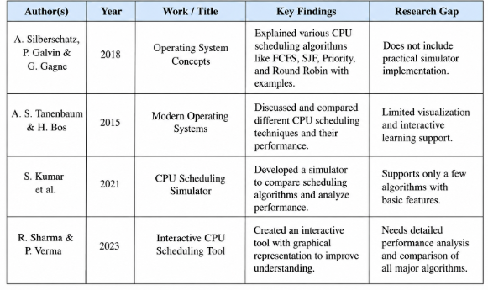
LITERATURE REVIEW

Slide 5
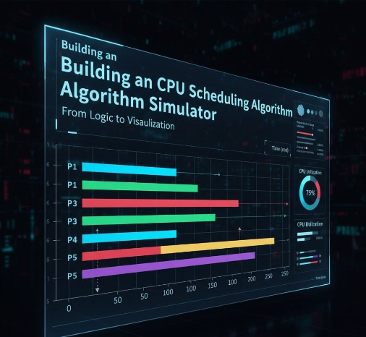
Problem Statement
Understanding CPU scheduling algorithms through theory alone is difficult.
Students find it hard to compare the performance of different scheduling algorithms.
Manual calculation of waiting time and turnaround time is time-consuming and error-prone.
There is a need for a simple tool to simulate CPU scheduling processes.
Existing tools may be complex or not suitable for beginners.

Slide 6
MODULES
Module 1: User Module
The user enters the process details and selects the CPU scheduling algorithm.
Module 2: Scheduling Module
The system executes the selected scheduling algorithm and decides the order of process execution.
Module 3: Processing Module
The simulator processes the tasks and calculates execution details such as waiting time and turnaround time.
Module 4: Result Module
The system displays the scheduling results, Gantt chart, and performance comparison of the algorithms.

